Slide 1
Melinda Carson, LCSW
School Social Workers Association of Georgia
Community Relations & Legislative Committee Chair District 4 Secretary
October 10, 2024

Slide 2
Our Vision
We envision schools where all children and their families have access to the resources needed to remove barriers and thrive and where School Social Workers are valued and integral parts within the educational systems in Georgia.
Our Mission
Through forums of professional development, continuous networking opportunities, and advocacy, the School Social Workers Association of Georgia supports the work of School Social Workers across the state as they employ a myriad of interventions and practices that maximize students' academic and emotional functioning.
The Role of School Social Workers on the Senate Safe Firearm Storage Study Committee
School Social Workers bring expertise in student mental health and community dynamics. We help identify challenges related to safe firearm storage, advocate for effective policies, and promote educational initiatives that raise awareness about responsible firearm practices. Our unique perspective is essential for developing comprehensive solutions that enhance safety in schools and communities.

Slide 3
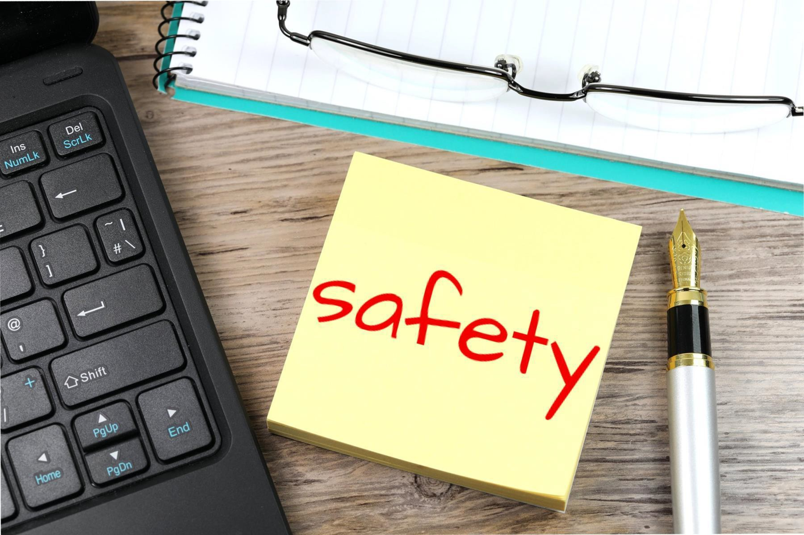
1. Early Identification and Intervention
School Social Workers play a essential role in promoting gun safety and prevention in schools by addressing the emotional, social, and mental health needs of students while also working to prevent violence, including gun-related incidents.
Our involvement in gun safety and prevention includes several key areas
Crisis Intervention and Postvention
Collaboration with School and Communities
Violence Prevention Programs
Policy Advocacy and Development
Threat Assessment and Prevention
Teams
7. Training and Professional Development

Slide 4
1. Resource limitations: Many school districts lack sufficient
funding to employ full-time Social Workers or comprehensive
mental health teams, hindering effective gun violence prevention efforts. Currently, the ratio of 1 School Social Worker to 2,475 students means that Social Workers often spend more time reacting to crises than developing proactive programs to address mental health barriers.
Balancing safety with student privacy: School Social Workers must navigate the tension between maintaining student privacy and reporting behaviors that could pose a threat to school safety.
Community factors: External influences, such as gun availability in the community, poverty, and exposure to violence, can complicate School Social Workers’ efforts to ensure student safety.
Challenges and Considerations

Slide 5
In essence, School Social Workers contribute to gun safety and prevention by addressing both individual student needs and larger systemic factors that impact school safety.

Slide 6
Together, we can create safer, more supportive school environments for all students.
Melinda Carson, LCSW
School Social Workers Association of Georgia

