Slide 1

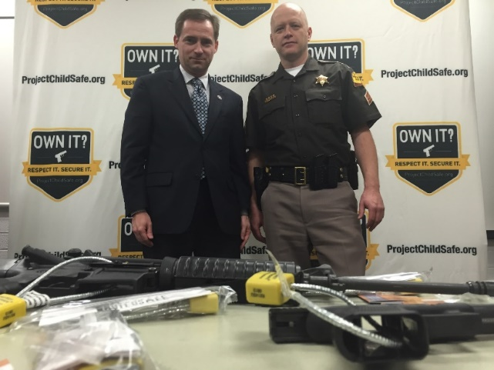
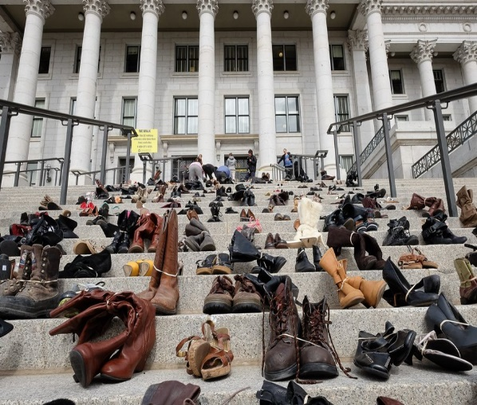
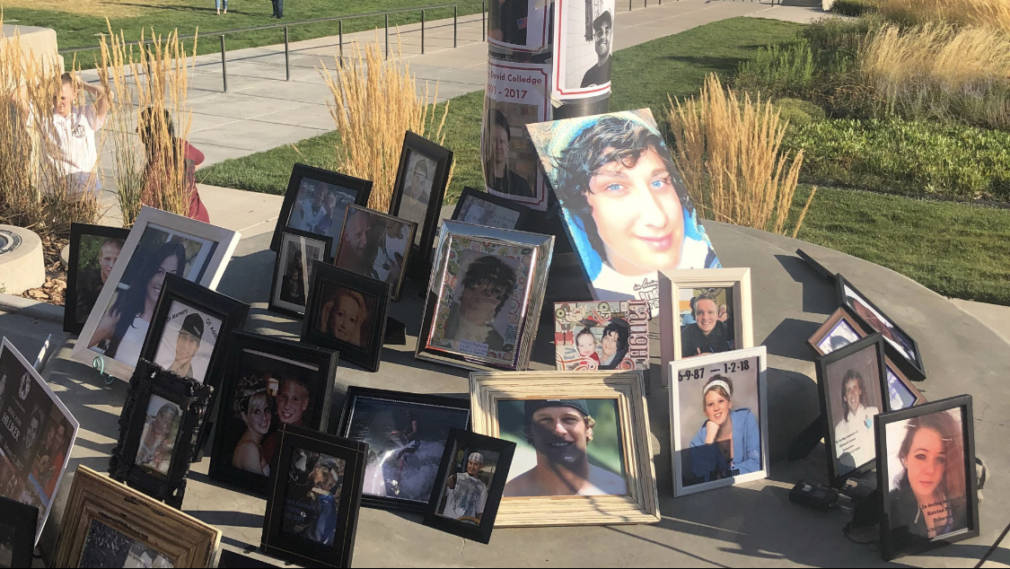
Utah Youth Mental Health
& Firearm Safe Storage Legislation
Utah State Legislature 2012-2024
Representative Steve Eliason
Utah House of Representatives

Slide 2

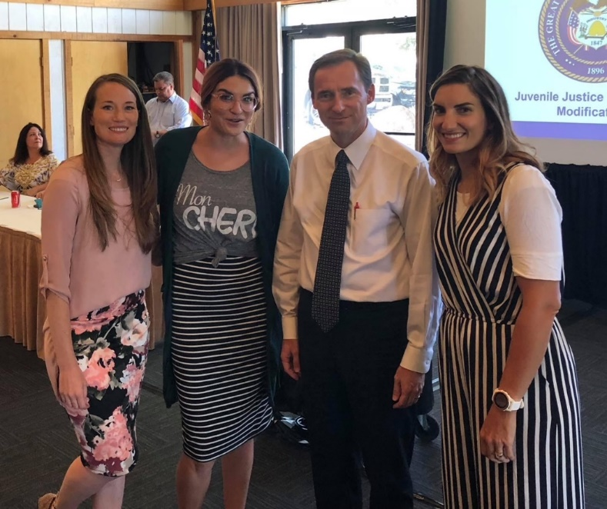

Slide 3
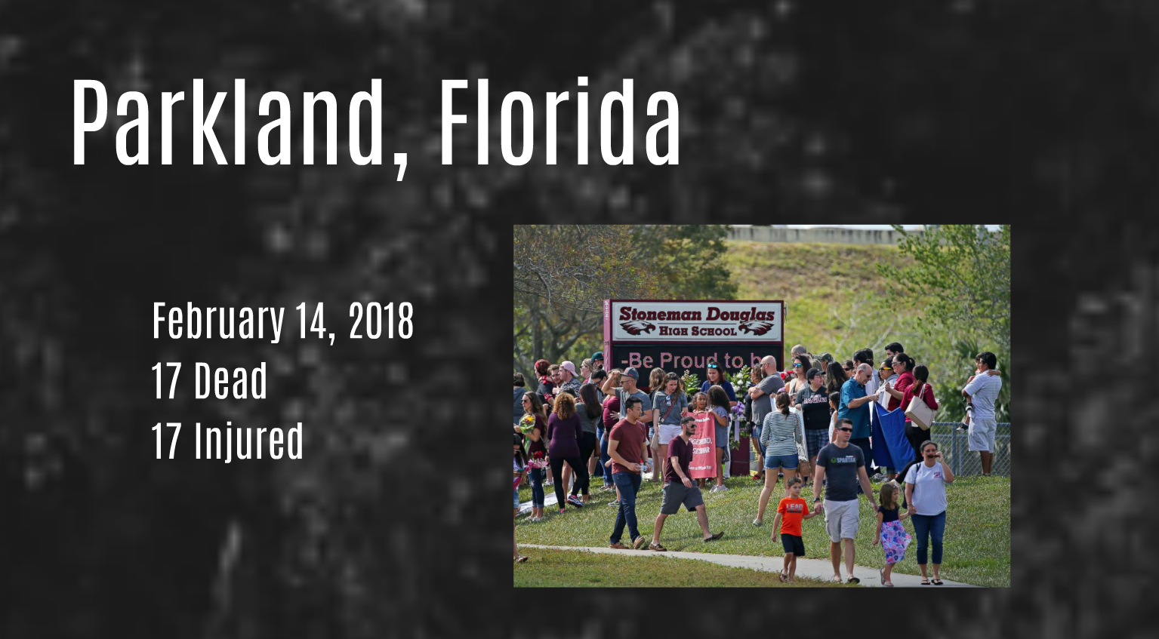
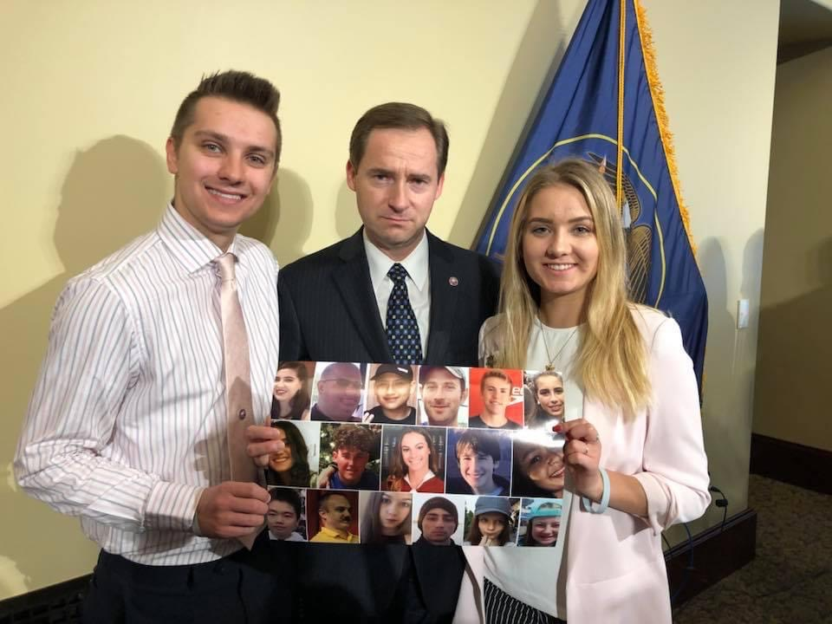
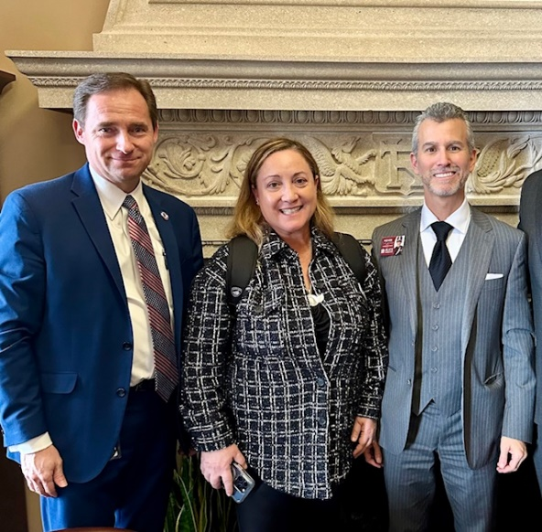

Slide 4


HB 298 “Parent Seminar on Youth Protection” 2013 legislation that required school districts to hold annual parent seminars on a range of topics, including suicide prevention.
  Status: Passed (House: 61-11-3; Senate: 22-4-3)
  Sponsor: Rep. Steve Eliason. Sen. Sponsor: Sen. Aaron Osmond.
  Fiscal Note: $0

Slide 5
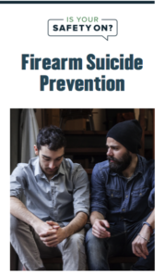
HB 134 “Firearm Safety Amendments” 2014 legislation that created a voluntary firearm safety program for suicide prevention, including the creation of a safety brochure and distribution of gun locks.
  Status: Passed (House:70-1-4 Senate: 22-4-3)
  Sponsor: Rep. Steve Eliason. Senate Sponsor: Sen. Stuart C. Reid.
    Cosponsors: Barlow, Chavez-Houck, Cosgrove, Greene, Handy, Ipson, Kennedy, Menlove, Ray, Redd, Wilcox.
  Fiscal Note: $196,000 (ongoing)

Slide 6

SB 23201 “School Safety Tip Line” 2014 legislation that established the School Safety Tip Line Commission within the Office of the Attorney General. This commission was charged with making recommendations to the Legislature regarding ways to improve student safety and mental health.
  Status: Passed (House: 67-2-6; Senate: 23-0-6)
  Sponsor: Senate Sponsor: Sen. Dan Thatcher, Rep. Steve Eliason.
  Fiscal Note: $6,200 One-time

Slide 7
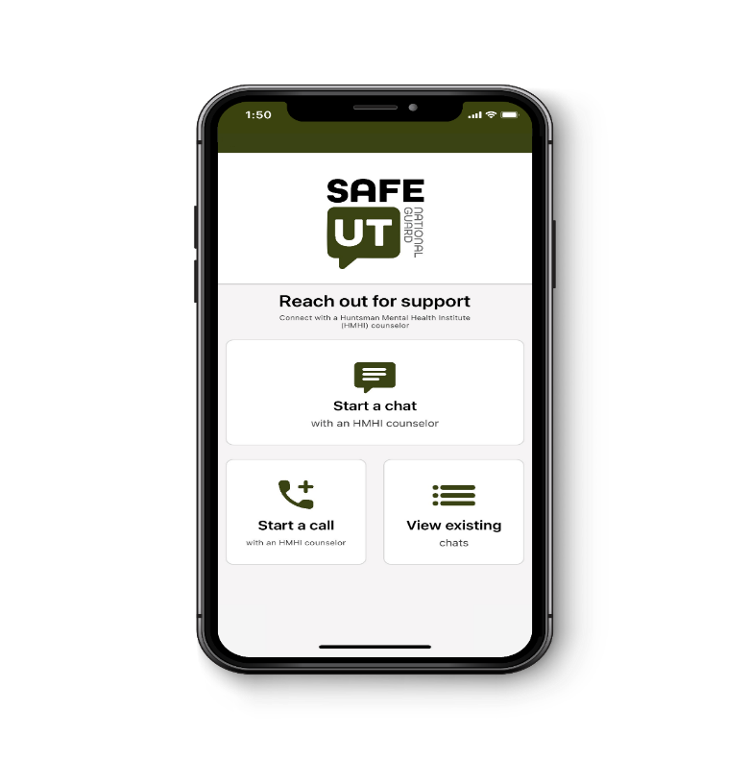
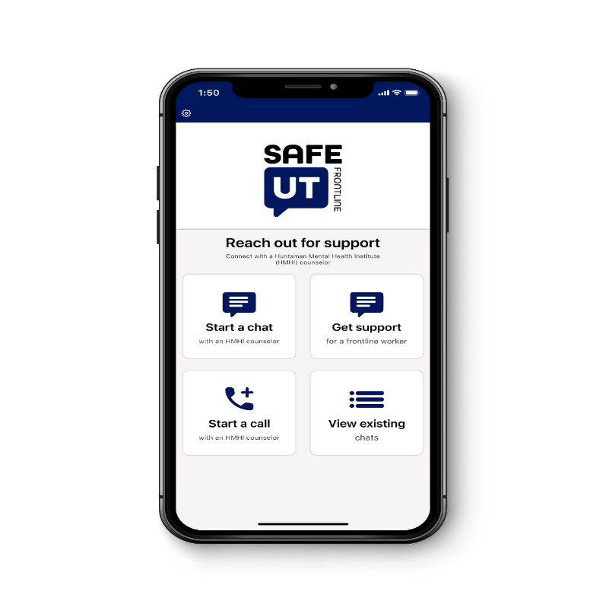
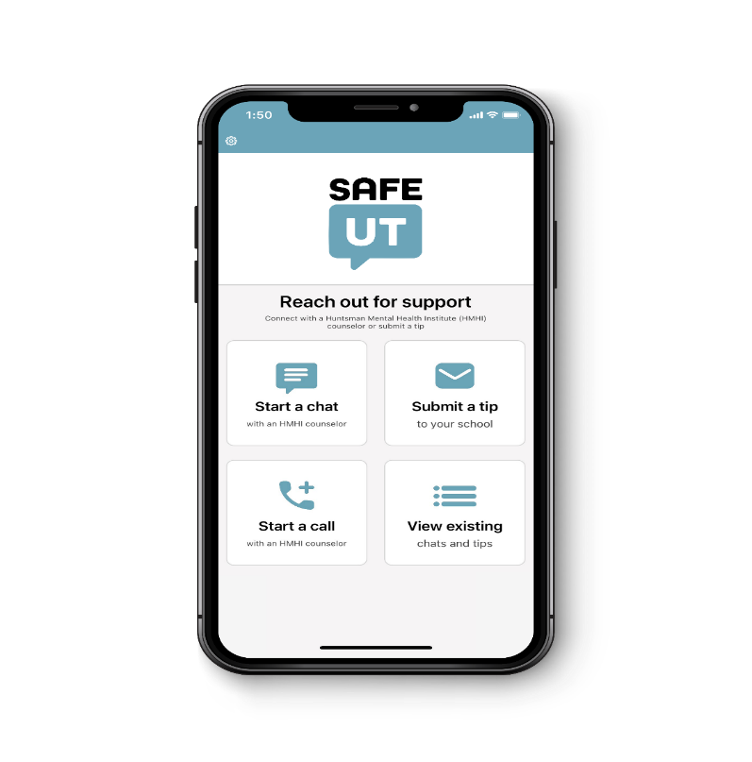
SB 175 “School Safety & Crisis Line” 2015 Legislation that created a student safety and crisis tip line commission (SafeUT).
  Status: Passed (Senate: 25-3-1; House: 70-1-4)
  Sponsor: Sen. Daniel W. Thatcher. House Sponsor: Rep. Steve Eliason.
  Fiscal Note: $298,400 (Ongoing: $148,400; One-time: $150,000)

Slide 8

Saying Something Could Save Someone
Utah is the national model for school safety and mental health tip lines with a behavioral health first approach
Submit confidential tips to counselors who triage safety risks
Coordination with school administrators and law enforcement to act on credible school safety concerns

Slide 9



SafeUT by the Numbers
July 1, 2021 – June 30, 2022
28,472
total chats
8,537
total K-12 & higher ed tips
Top 5 Tip Categories:
Suicide (1,579)
Bullying (994)
School threats/violence (801)
Crisis (704)
Mental health (490)
349
lifesaving interventions
Notes:
Dema –
Hit first major milestone of 1 million back and forth messages – robust, supportive conversations making a life saving impact

Slide 10

Threats & Potential Acts of Violence Reported in FY22
801
Sub-Categories for Threats & Potential Acts of Violence
1. | Guns | 157 (19.6%) | 8. | Threats | 53
2. | Planned School Attack | 149 (18.6%) | 9. | Knives | 40
3. | Assault | 75 | 10. | Planned Fights | 31
4. | Fighting | 70 | 11. | Explosives | 18
5. | Weapons | 66 | 12. | Fire Starting | 10
6. | Crime | 65 | 13. | Stalking | 3
7. | Violence | 64

Slide 11
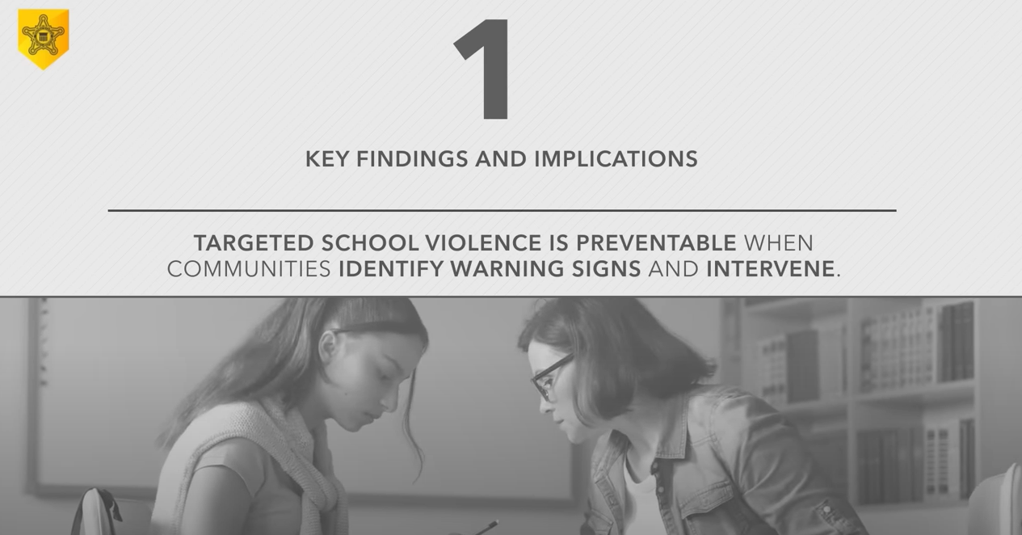
US Secret Service report: “Averting Targeted School Violence”
Notes:
A 2021 study examines 67 disrupted plots against K-12 schools between 2006-2018. All 67 potential plots were disrupted and violence averted because someone saw something and then said something. https://www.secretservice.gov/sites/default/files/reports/2021-03/USSS%20Averting%20Targeted%20School%20Violence.2021.03.pdf

Slide 12
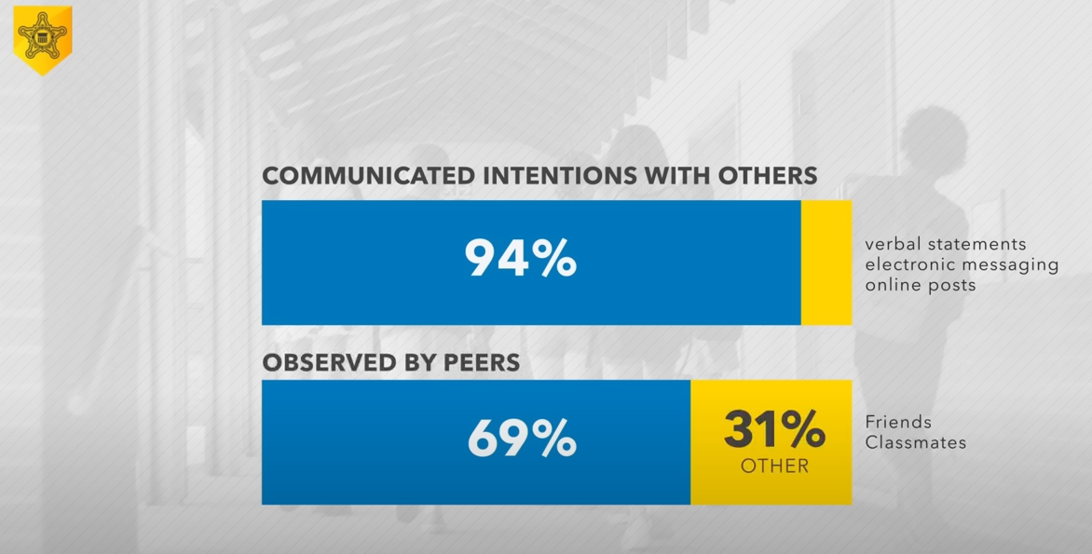
US Secret Service report: “Averting Targeted School Violence”
Notes:
A 2021 study examines 67 disrupted plots against K-12 schools between 2006-2018. All 67 potential plots were disrupted and violence averted because someone saw something and then said something. https://www.secretservice.gov/sites/default/files/reports/2021-03/USSS%20Averting%20Targeted%20School%20Violence.2021.03.pdf

Slide 13
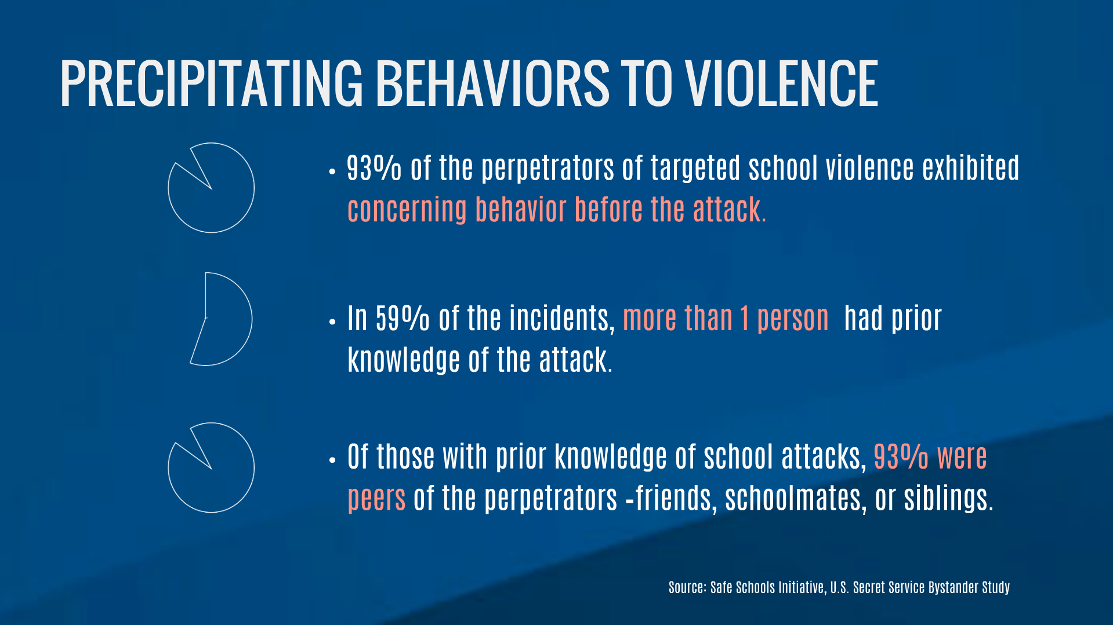

Slide 14
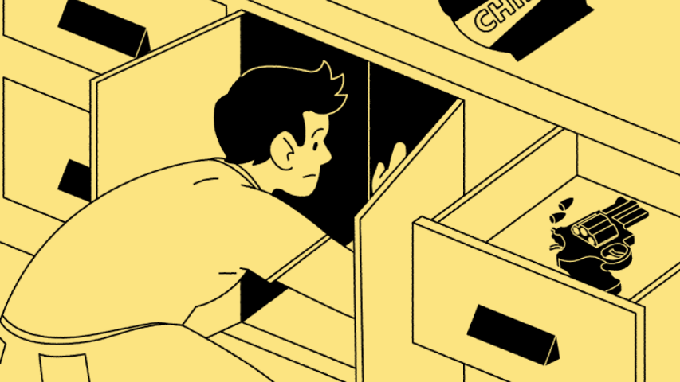
Most school shooters get guns from home – and more weapons are there since the pandemic
The number of firearms in households with teenagers has increased since the onset of COVID-19
December 2, 2021 6:00 PM
Author|Patrick Carter, M.D
In around 74% of incidents, the firearm used was obtained from the student's home or from that of a friend or relative.

Slide 15

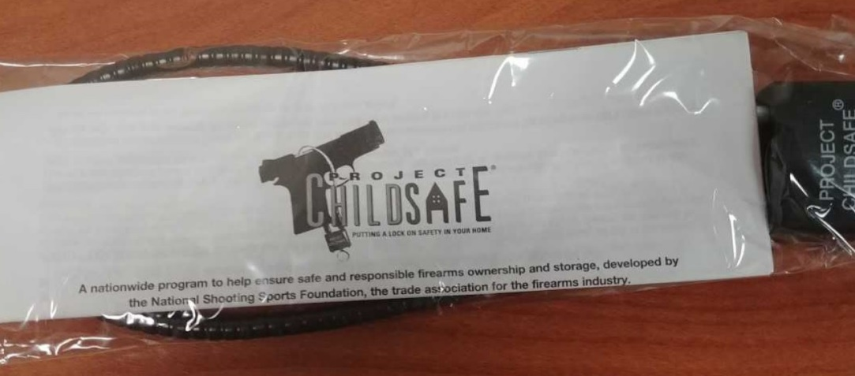
HB 364 “Suicide Prevention Amendments” 2015 legislation that appropriated ongoing funding for purchase and distribution of gun locks.
  Status: Passed (House: 71-0-4; Senate: 28-0-1)
  Sponsor: Rep. Steve Eliason. Senate Sponsor: Sen. J. Stuart Adams.
  Cosponsor: Rep. J. Fawson
  Fiscal Note: $616,000 (Ongoing: $256,000; One-time: $360,000)

Slide 16
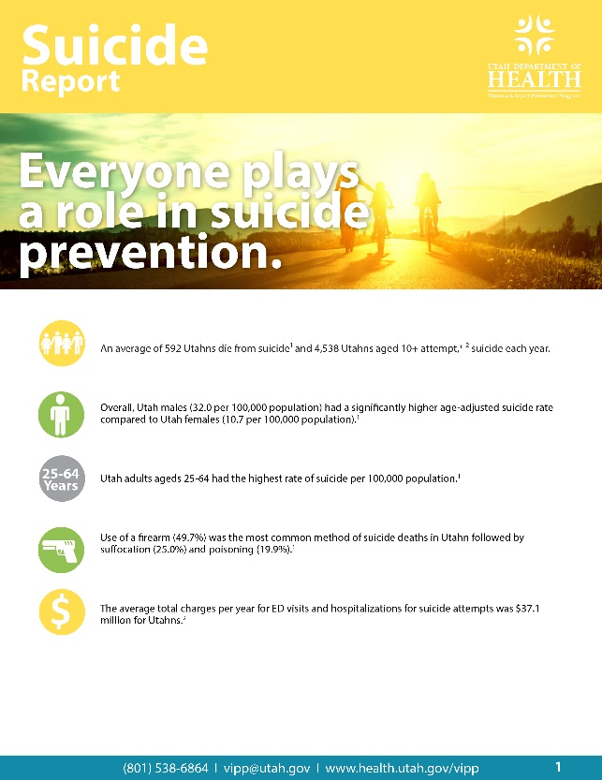
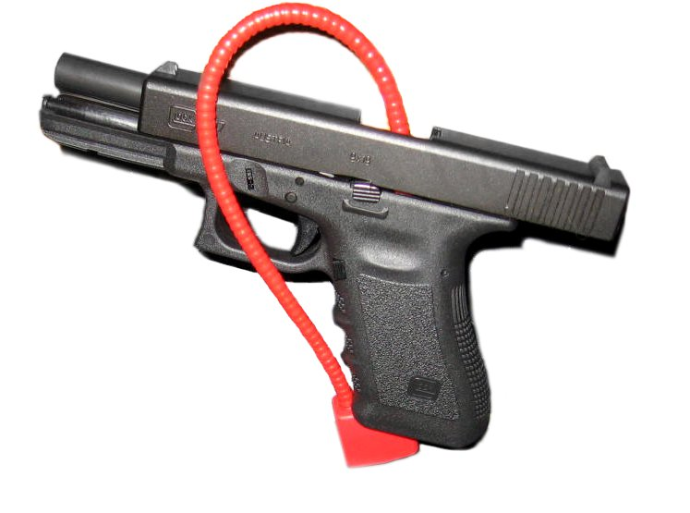
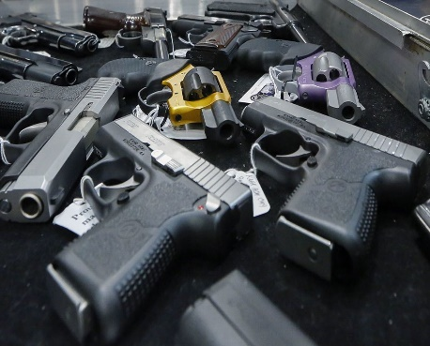
HB 440 “Suicide Prevention & Gun Data Study” 2016 legislation that required suicide prevention/gun data study.
  Status: Passed (House: 73-1-1; Senate: 19-6-4)
  Sponsor: Rep. Brian S. King. Senate Sponsor: Sen. Curtis S. Bramble.
  Fiscal Note: $140,000 (one-time)

Slide 17
2019 Suicide and Firearm Injury in Utah Report
Key Results from Study:
Suicides outnumber homicides 8-1 in Utah
85% of firearm deaths in Utah were suicides and firearms account for half of all suicides
Metro counties had higher rates of suicide attempts. Rural counties had higher rates of suicide deaths. The higher rural death rate was driven by greater use of firearms in attempts, not by higher attempt rate.
The higher suicide rate in rural counties was driven by a higher firearm suicide rate among all ages (including youth)

Slide 18
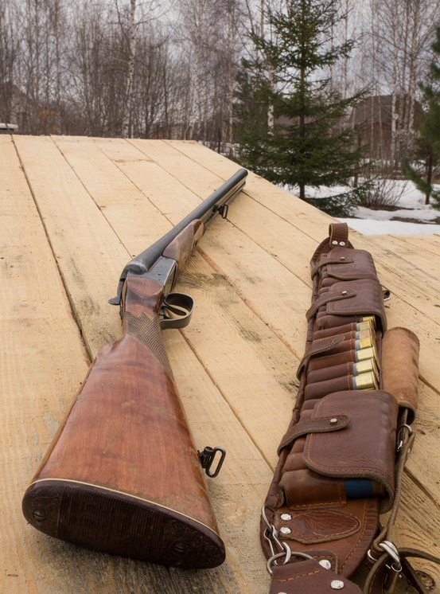
2019 Suicide and Firearm Injury in Utah Report
Key Results from Study:
What percent of rural youths’ gun suicides are by rifle or shotgun?
62%
State action: State law now provides cable locks to accompany all sales of rifles & shotguns from gun retailers.

Slide 19

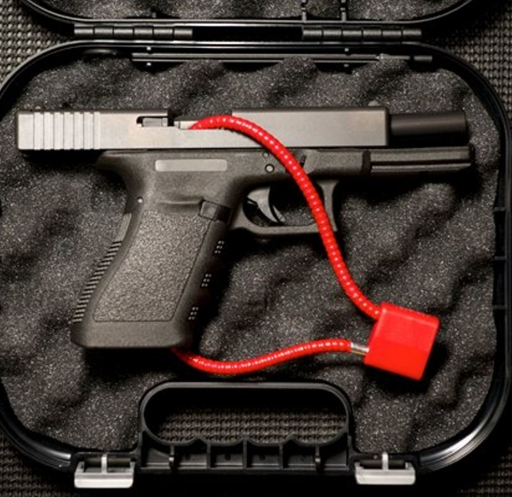
HB 17 ”Firearm Violence and Suicide Prevention Amendments” 2019 legislation that reenacts and modifies previously sunsetted provisions relating to a voluntary firearm safety program and an online suicide prevention education course for concealed firearm permit holders.
  Status: Passed (House: 60-8-7; Senate: 26-0-3)
  Sponsor: Rep. Steve Eliason. Senate Sponsor: Sen. Curtis Bramble
  Fiscal Note: $25,000 (ongoing)

Slide 20
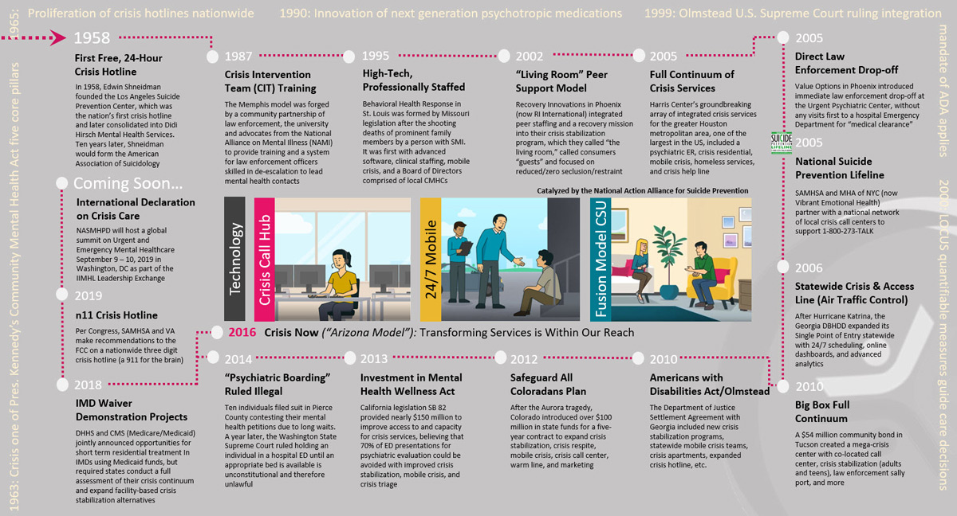
“HB 32 Crisis Services Amendments” 2020 legislation that:
  Funds up to four 23 hour crisis receiving centers;
  Increases the number of mobile crisis outreach teams (MCOTS), specifically in rural areas of the state;
  Creates a Statewide Warm Line 1-833-SPEAKUT;
  Provides funding to SAFE UT to support operations; and
  Provides funding to the Governor’s Suicide Prevention Fund’s grant program
  Funding:
    $2,400,000 Ongoing – Rural MCOT Teams
    $8,035,000 Ongoing - Crisis Receiving Centers/Warm Line
    $5,652,000 One-time – Crisis Receiving Centers
    $250,000 Ongoing – SAFE UT for First Responders
    $100,000 Ongoing – Suicide prevention messaging (Live On Utah campaign)
    $250,000 One-time, $25K Ongoing - MCOT Vehicles
Status: Passed both the House & Senate Unanimously!
  Sponsor: Rep. Steve Eliason Senate Sponsor: Senator Dan Thatcher

Slide 21


Slide 22


“HB 323 School Mental Health Amendments” 2020 legislation:
  Requires the Utah Division of Substance Abuse and Mental Health Division to work with the Utah State Board of Education to develop age appropriate, evidence based, screeners to be used voluntarily on a Statewide basis.
  Prohibits student mental health screening without parental consent.
  Sets standards for participating local education agencies (LEAs) to implement student mental health screenings.
  Requires a report on the screening programs to the State Suicide Prevention
  Coalition and the Education Interim Committee;
  Status: Passed in the 2020 Legislative Session.
  Status: Passed (House: 44-28-3 Senate: 19-9-1)
  Sponsor: Rep. Steve Eliason. Senate Sponsor: Senator Ann Millner
  Fiscal Note: $500,000 (ongoing)

Slide 23
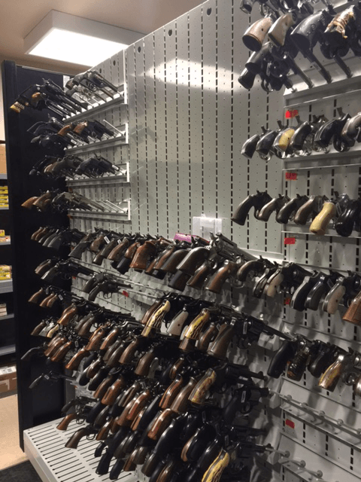
Suicide Prevention Policy in Utah: 2021
“HB 200 – Firearm Safe Harbor Amendments”:
Clarifies that a cohabitant or an owner cohabitant may surrender a firearm to law enforcement;
Allows law enforcement officers to receive firearms;
Requires a law enforcement agency to return a firearm to the owner upon request.
  Status: Passed (House: 73-0-2; Senate: 25-0-4)
  Sponsor: Rep. Cory Maloy Senate Sponsor: Sen. Jake Anderegg
  Fiscal Note: $Zero

Slide 24
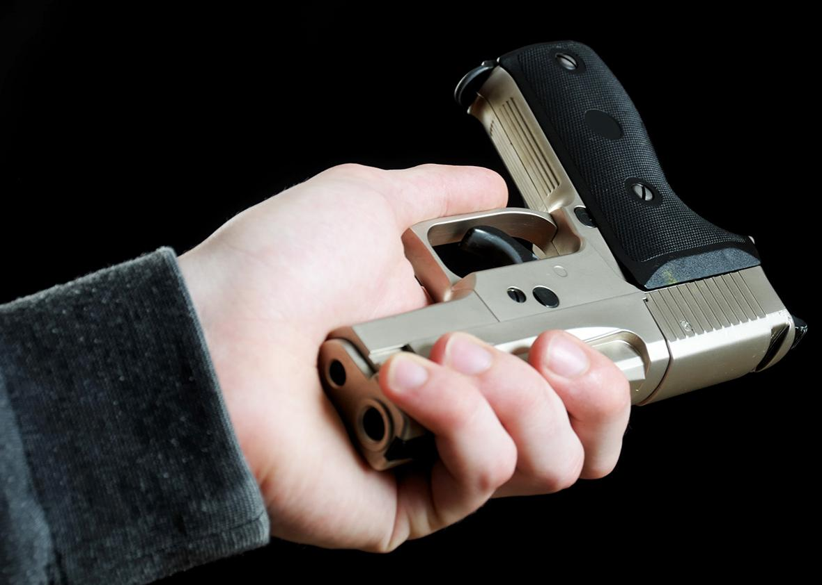
“HB 300 – Voluntary Firearm Restrictions Amendments”:
Creates a voluntary firearm restricted list that allows an individual to request to be restricted from purchasing or possessing firearms for a period of time or indefinitely.
Allows an individual seeking to be placed on a voluntary restricted list to direct the individual’s health care provider to deliver the opt in form to the State for inclusion on to the restricted list.
  Status: Passed (House: 73-0-2; Senate: 25-0-4)
  Sponsor: Rep. Steve Eliason Senate Sponsor: Sen. Mike Kennedy
  Fiscal Note: $400 One-time

Slide 25
Key Takeaways:
State level legislation is making a difference, while Federal efforts remain stalled.
Early warning systems, such as SAFE UT, that can identify and neutralize potential homicidal and/or suicidal events, are one of the most effective tools to reduce mass shootings and suicides.
Efforts to reduce access to lethal means, particularly firearms, is one of the best ways to reduce suicides and mass school shootings. This includes public service announcement campaigns (PSA).
If virtually all mass school shooters are suffering from some type of psychiatric illness, the ability to screen school age children for mental illnesses, with appropriate referrals to treatment, is a key strategy to prevent both mass school shootings and suicides.
Training for mental health clinicians regarding access to lethal means counseling is critical as well as are tools to allow patients to put their name on a do not sell, or possess, registry to both prevent suicides and homicides.

Slide 26
Questions?
Representative Steve Eliason
Utah House of Representatives
Cell: 801-673-4748
Email: seliason@le.utah.gov

